Slide 1
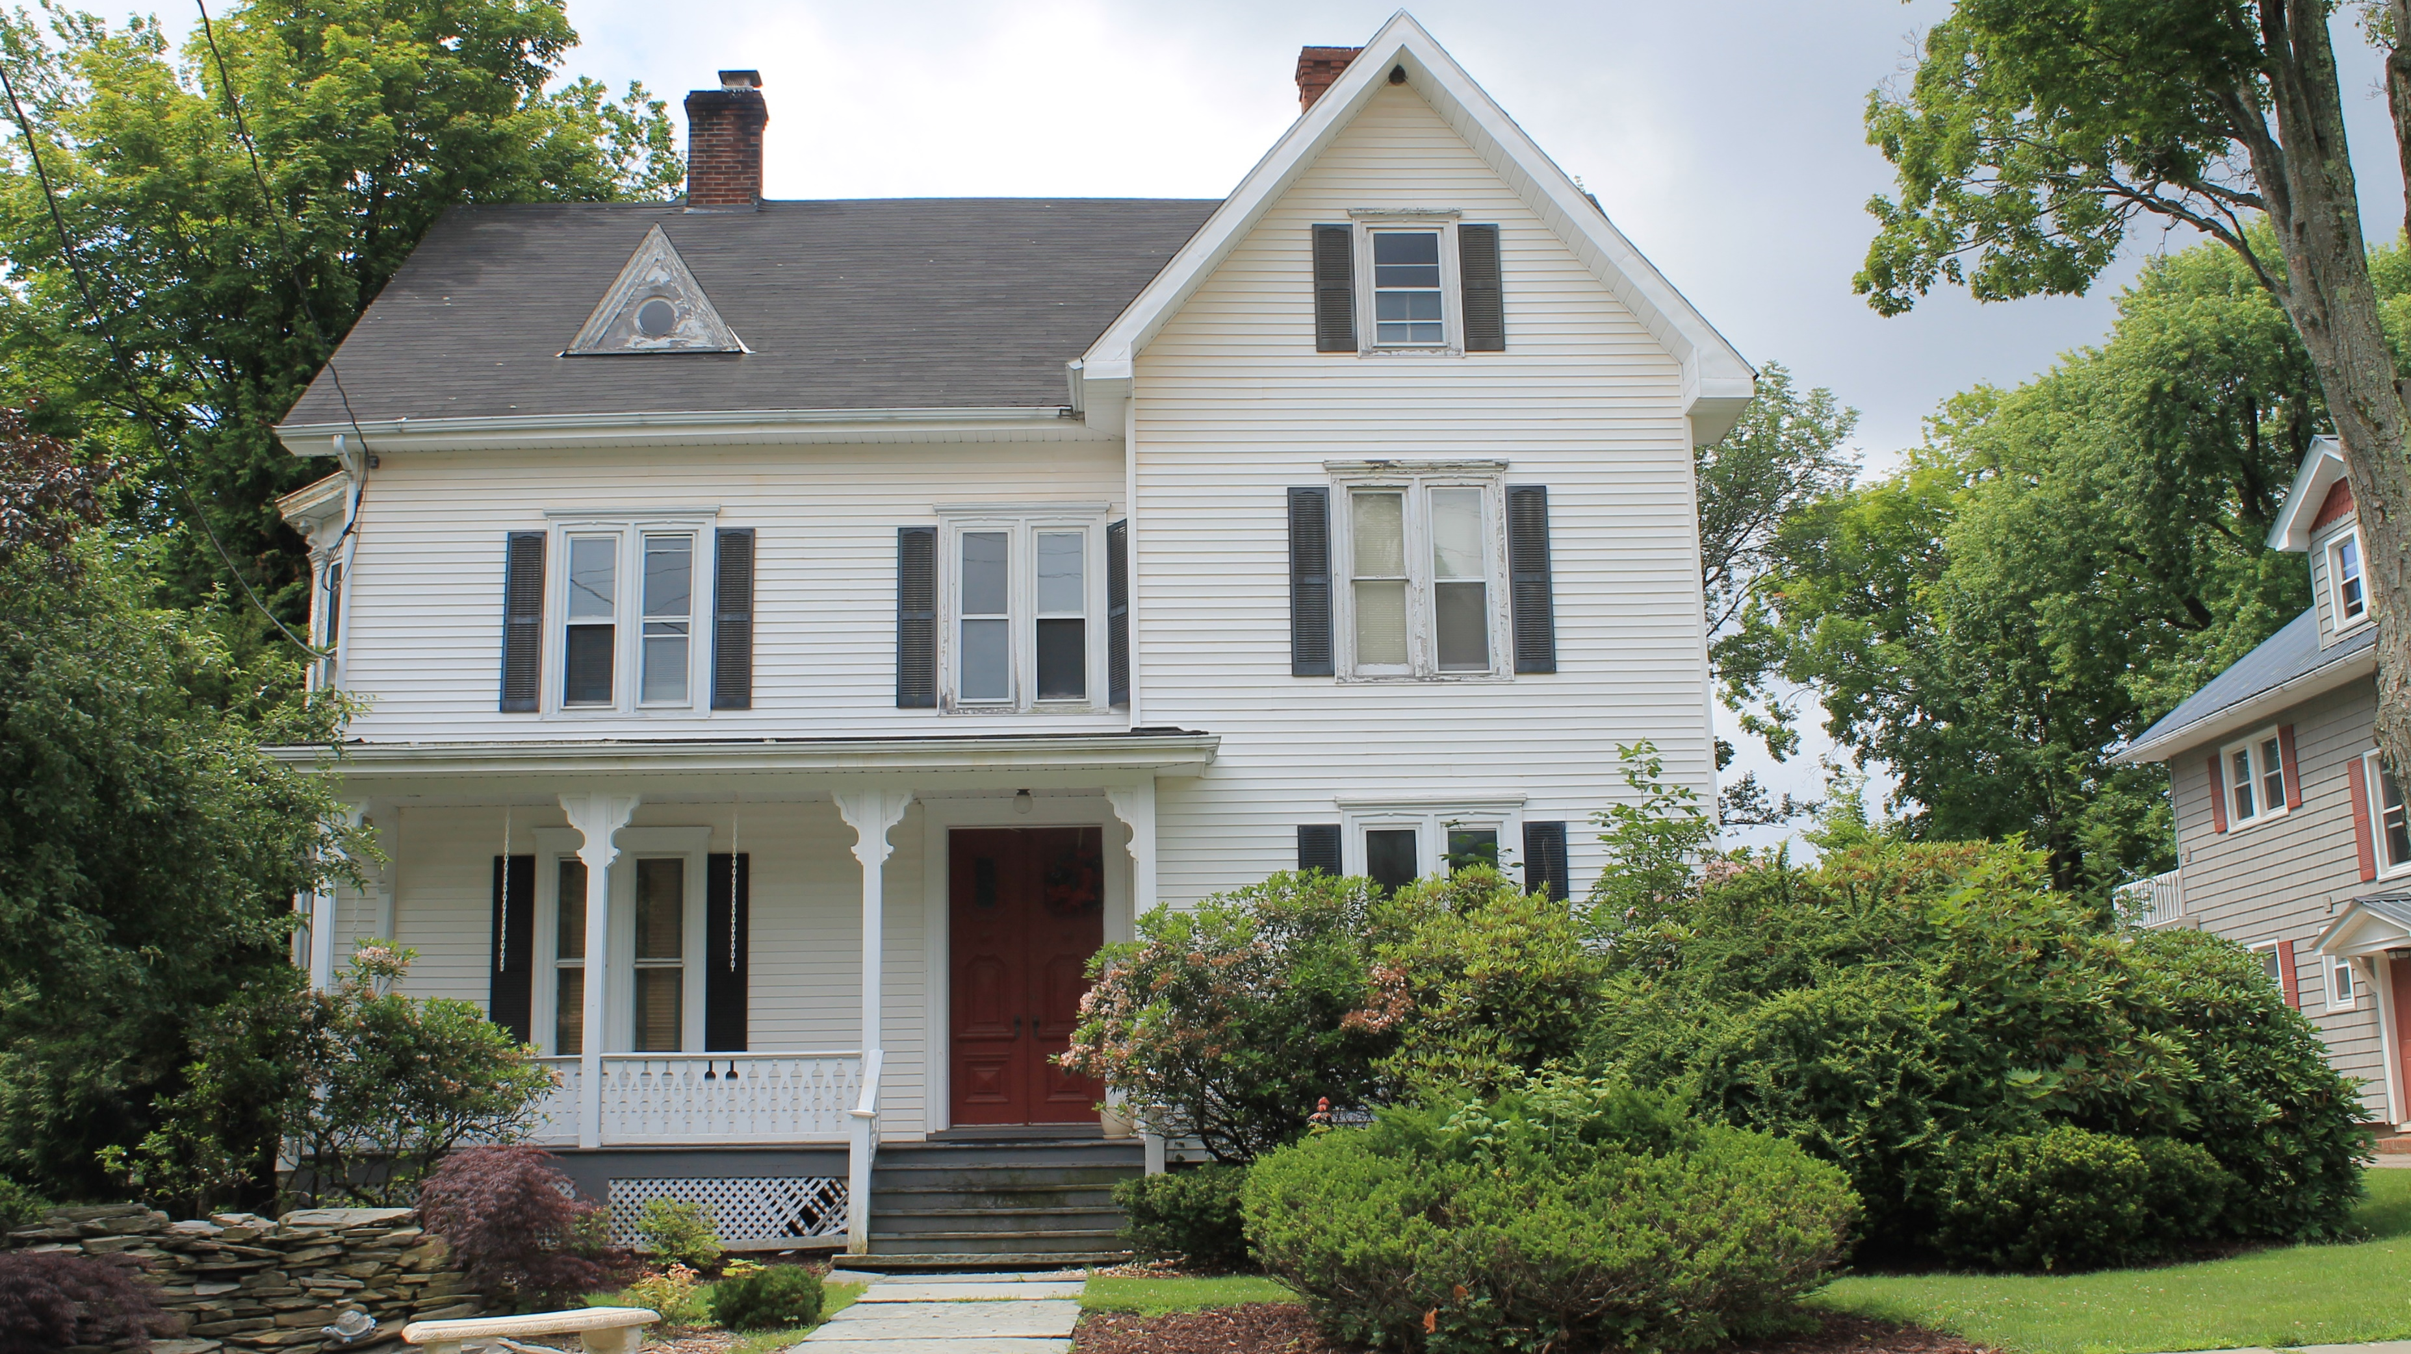

Project 4 PRESENTATION
Group 2
Greg Thomas
Hilari Waters
Jon Haas
Housing Prices Machine Learning
University of Kansas – Data Analytics Boot Camp
This Photo by Unknown Author is licensed under CC BY-SA

Slide 2
Project Description & Motivation:
Analysis of USA Real Estate Dataset (2.2M+ listings from Kaggle.com)
For businesses, employees and people looking to move their permanent residence location, it is important to know and understand the cost of purchasing a home in the new location.
Often times, wages/salaries may be similar, between locations.
However the cost of housing maybe considerably different.

Slide 3
Specific Needs and Why?
HME, Inc.’s headquarters are located in Topeka, Kansas where all major operations and fabrications are completed.
However, HME has also established satellite offices in larger cities which include Kansas City, Denver, and Dallas.
The satellite offices include key positions for Project Management, Estimating, Sales, Accounting, Steel Detailing (drafting), and Engineering.
HME also recently added Data Analytics to list!

Slide 4
Specific Needs and Why? (continued)
As HME has grown to over 500 employees, the management team has realized there is a shortage of talented, experienced, and qualified individuals in the Topeka market.
HME must recruit outside of Topeka to fullfill key positions.
College Grads want to live in big cities.
If HME is going to be competitive in the job marketplace at major universities,
HME must have positions available in attractive areas of large cities.

Slide 5
Specific Needs and Why? (continued)
In order to bring in young engineers, accountants, construction managers, etc.
HME must also relocate experienced managers capable of training and managing the college grads.
Thus, existing Topeka managers moving to other larger cities, may need compensated for cost of living adjustments.
Housing can be a major portion of adjustment.
For the convenience and attractiveness of it’s satellite offices, HME needs to consider attractive locations close to the housing needs of it’s current and future employees.

Slide 6
The Dataset Being Considered:
We choose to Kaggle.com’s “USA Real Estate Dataset.
It is a large dataset with over 2.2 M home listings in the U.S.
The dataset included 10 columns of information:
Price – Price/sqft, and Price for number of bedrooms were considered
Bed – We felt very important, but limited our analysis to 2, 3, and 4 bedrooms
City – We looked at HME’s Satellite office cities (KC, Denver, Dallas, and Topeka)
State – We found important. 3 of the cities in analysis were in multiple states
zip_code – We used to identify key areas of cities
House-size – We used house size as square feet to calculate $/sqft

Slide 7
The Resources:
Kaggle.com’s “USA Real Estate Dataset.
Google Colab “Notebook”
Google Docs
Matplotlib
Numpy
Pandas
Seaborn
Sklearn
Tableau
Github
One Hot Encoding
Random Forest
Gradient Boosting Regression

Slide 8
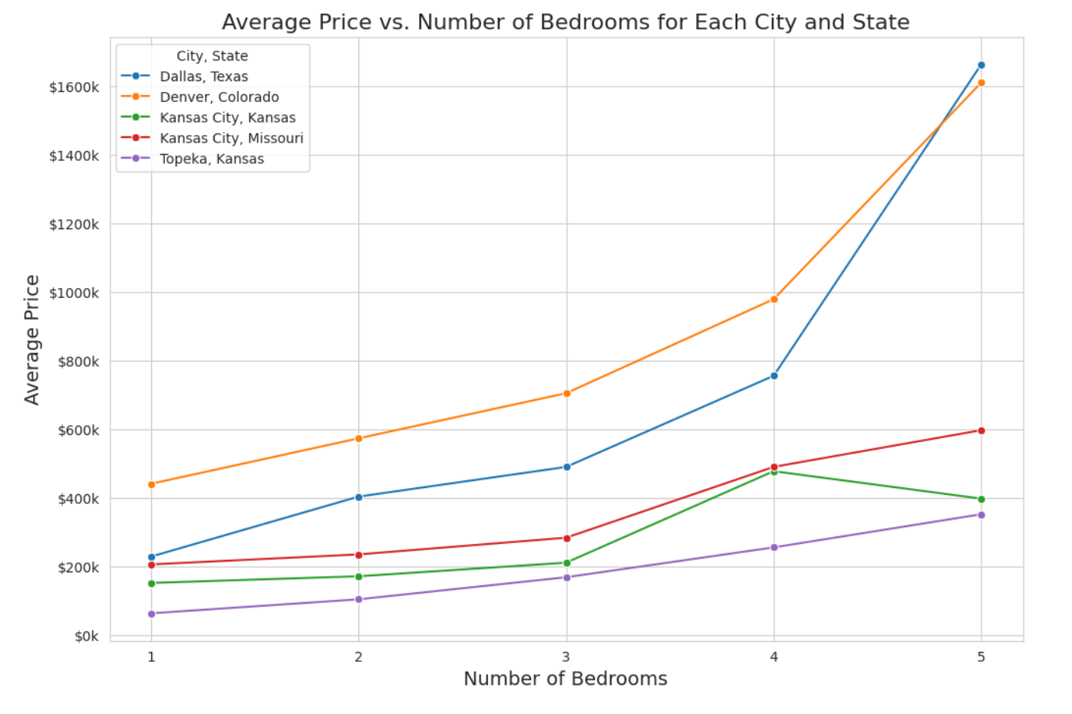
The Data:
Data included from 1 to 22 bedrooms. First we choose to get a feel for the data for the for each city, but limited from 1 to 5 bedrooms.

Slide 9
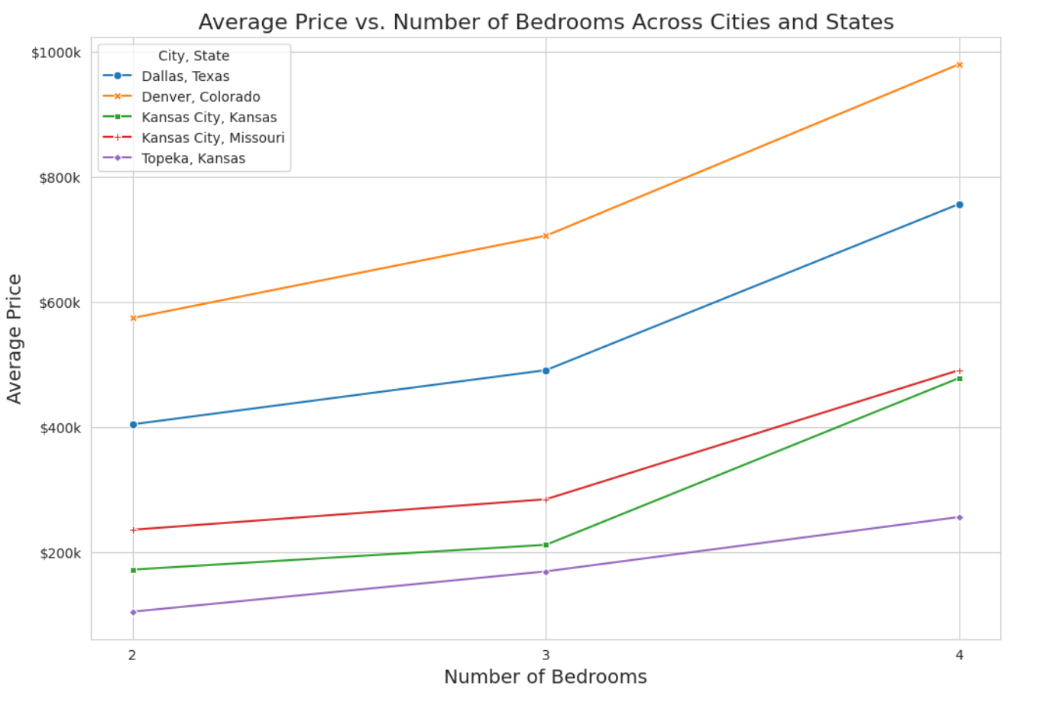
The Data:
We then limited to min. of 2 bedrooms and max. of 4 bedrooms.

Slide 10
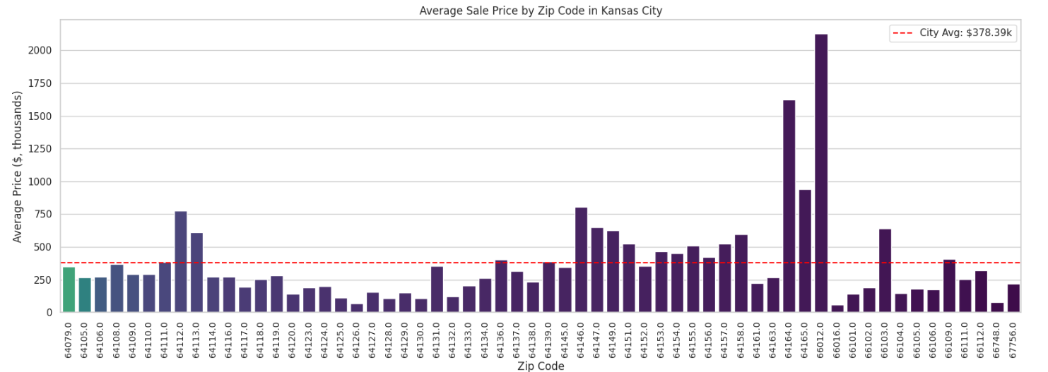
The Data:
We then wanted to get a feel for the data by City and prices by zip code.

Slide 11
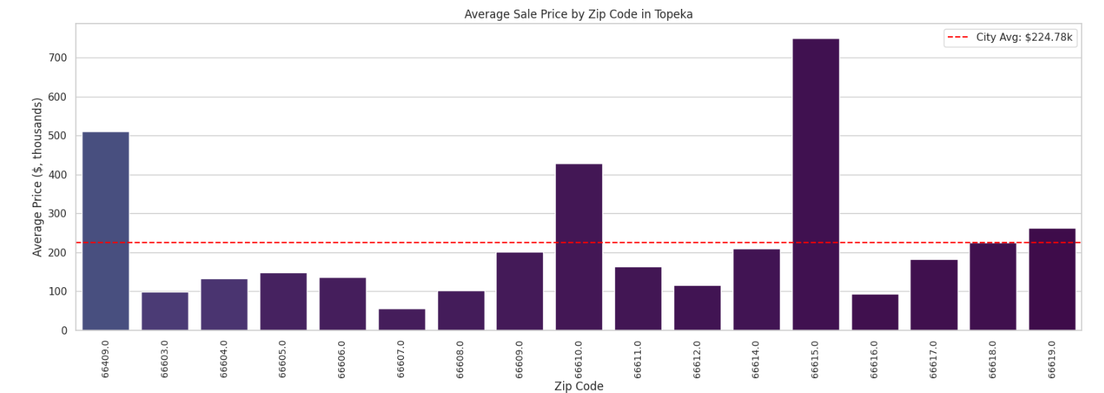
The Data:
We then wanted to get a feel for the data by City and prices by zip code.

Slide 12
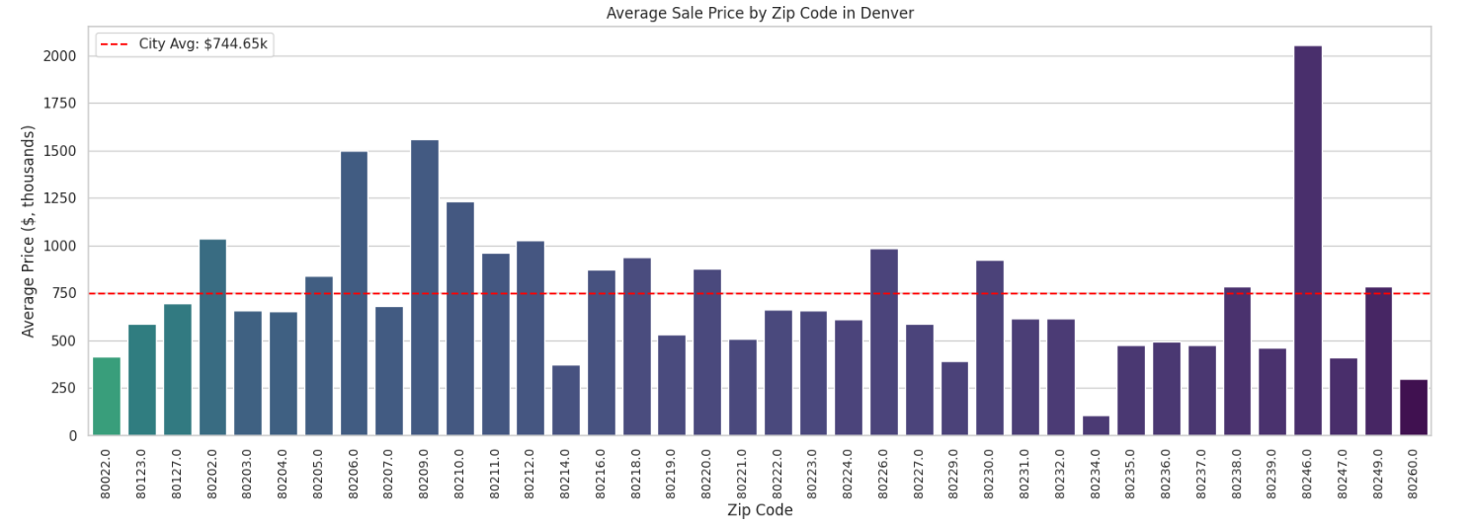
The Data:
We then wanted to get a feel for the data by City and prices by zip code.

Slide 13
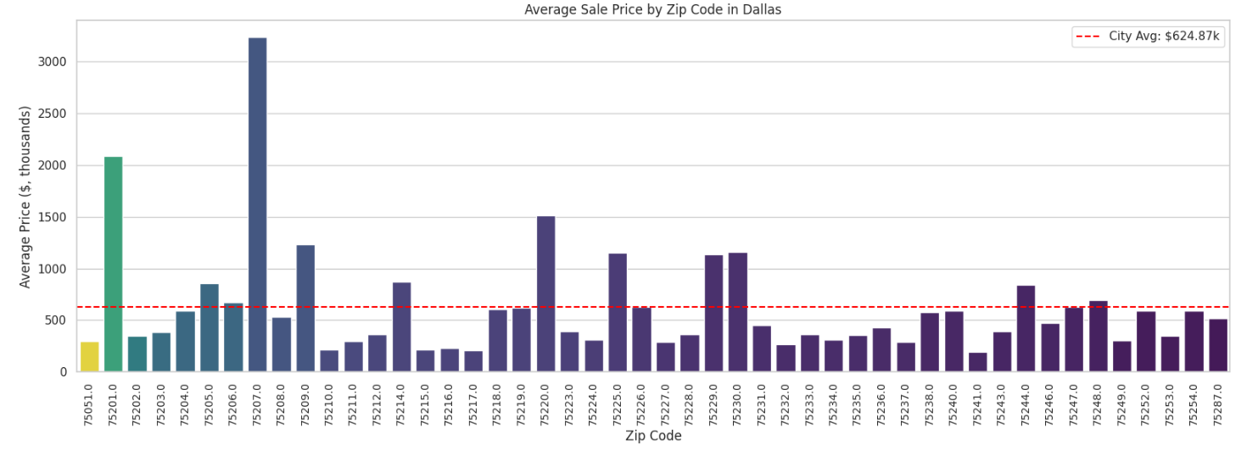
The Data:
We then wanted to get a feel for the data by City and prices by zip code.

Slide 14
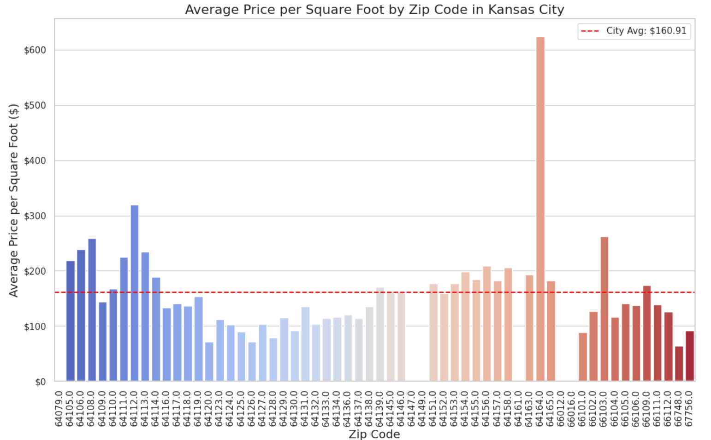
The Data:
When then wanted to get a feel for the data by City and prices/sqft by zip code.

Slide 15
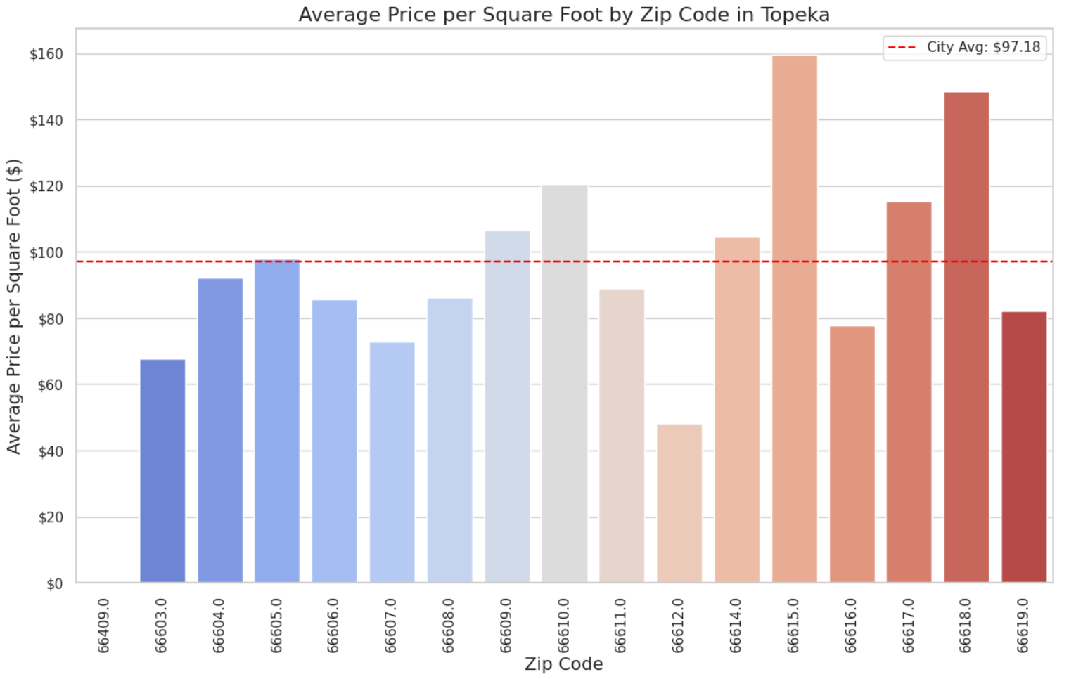
The Data:
We then wanted to get a feel for the data by City and prices/sqft by zip code.

Slide 16
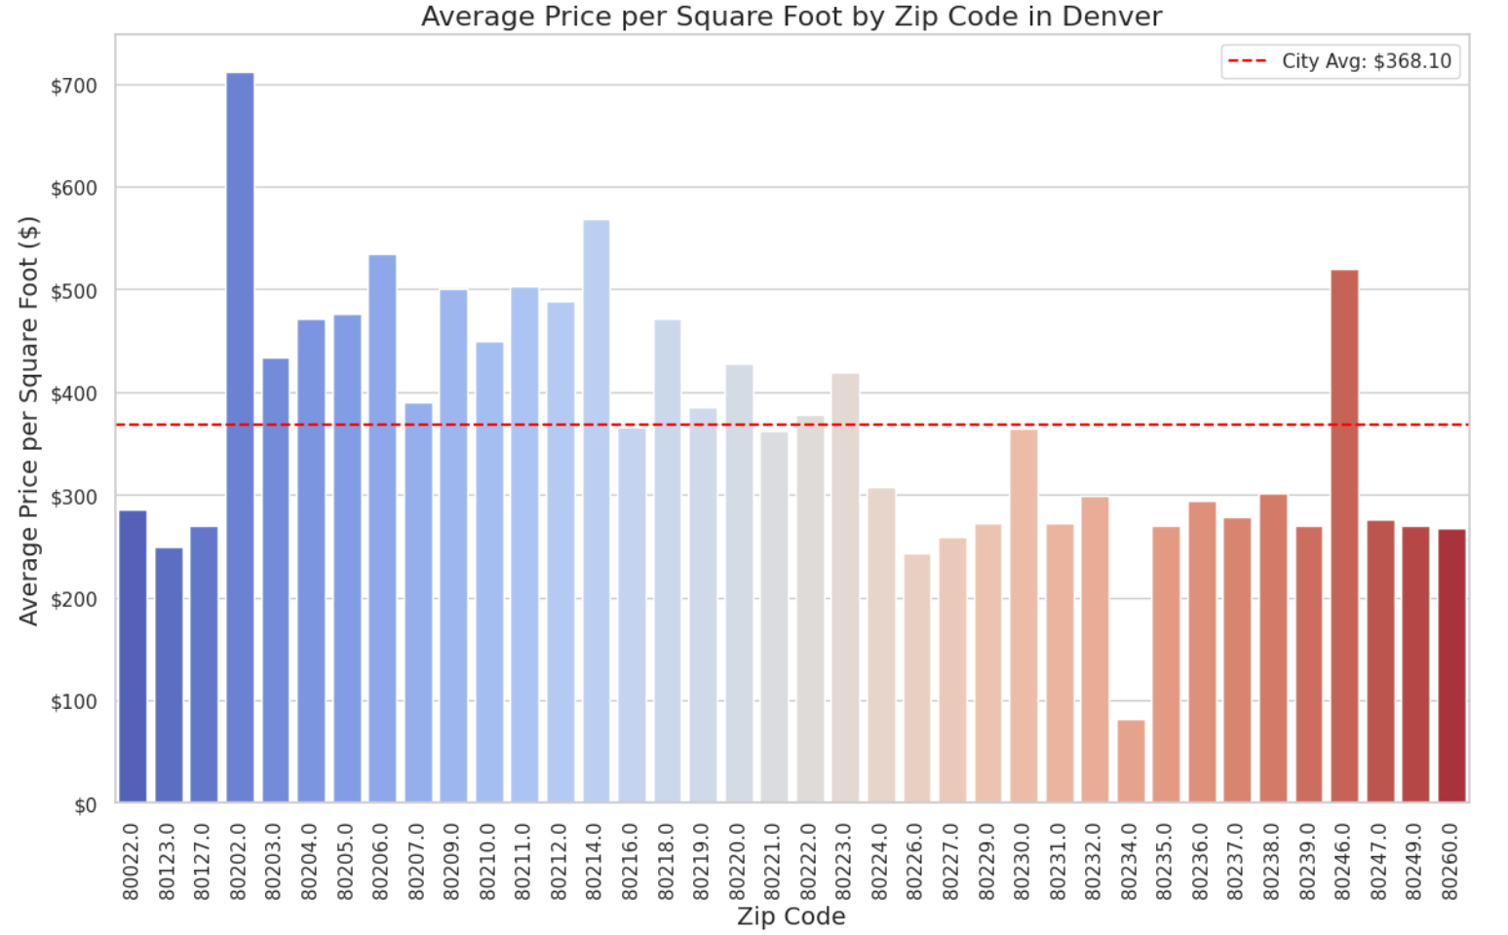
The Data:
We then wanted to get a feel for the data by City and prices/sqft by zip code.

Slide 17
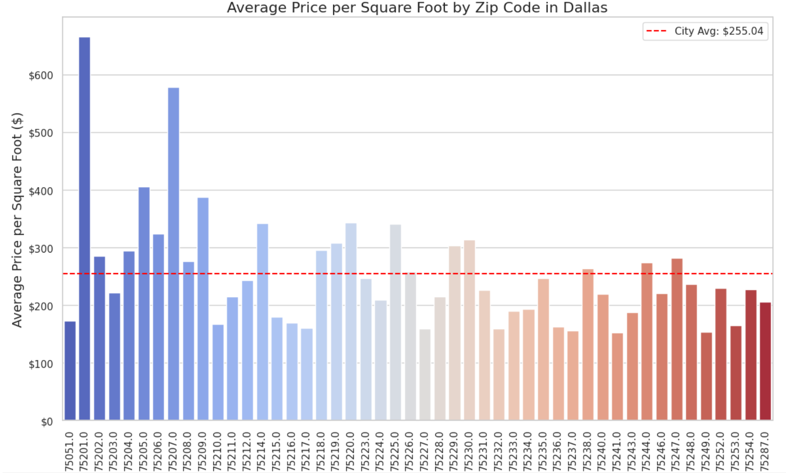
The Data:
We then wanted to get a feel for the data by City and prices/sqft by zip code.

Slide 18
The Models
Linear Regression
One Hot Encoding
Random Forest
One Hot Encoding
Gradient Boosting Regression

Slide 19
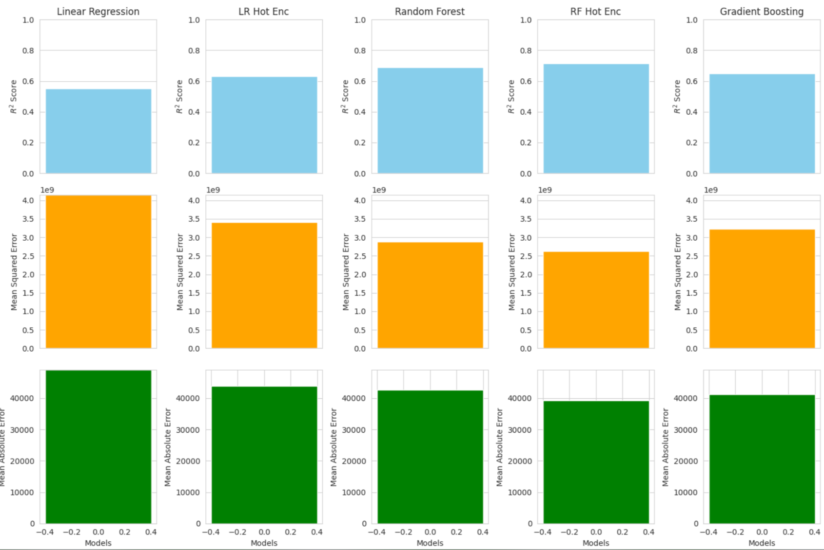
The Models: Topeka – 66609, 4 bed, 2000 sqft

Slide 20
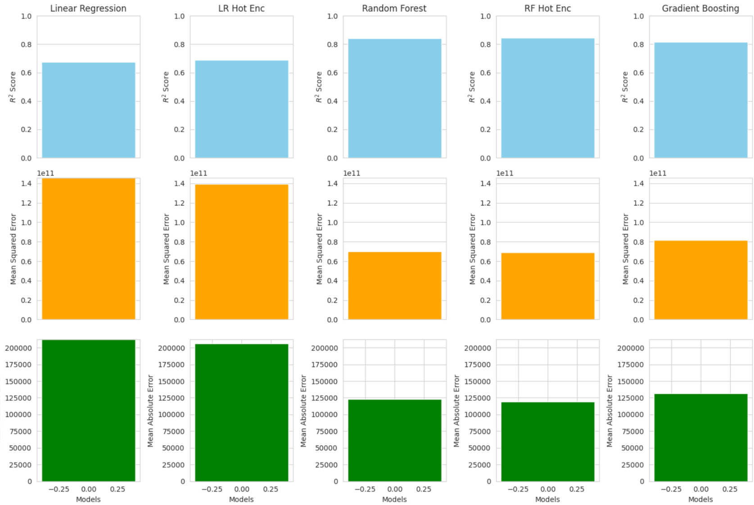
The Models: Dallas – 75218, 4 bed, 2000 sqft

Slide 21
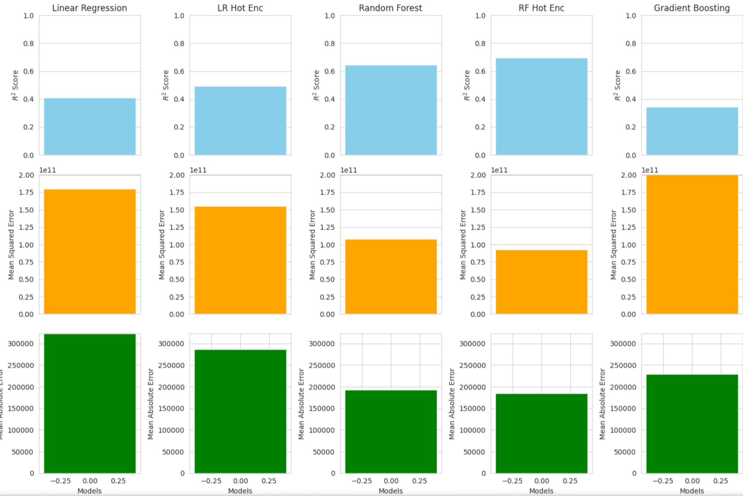
The Models: Denver – 80204, 4 bed, 2000 sqft

Slide 22
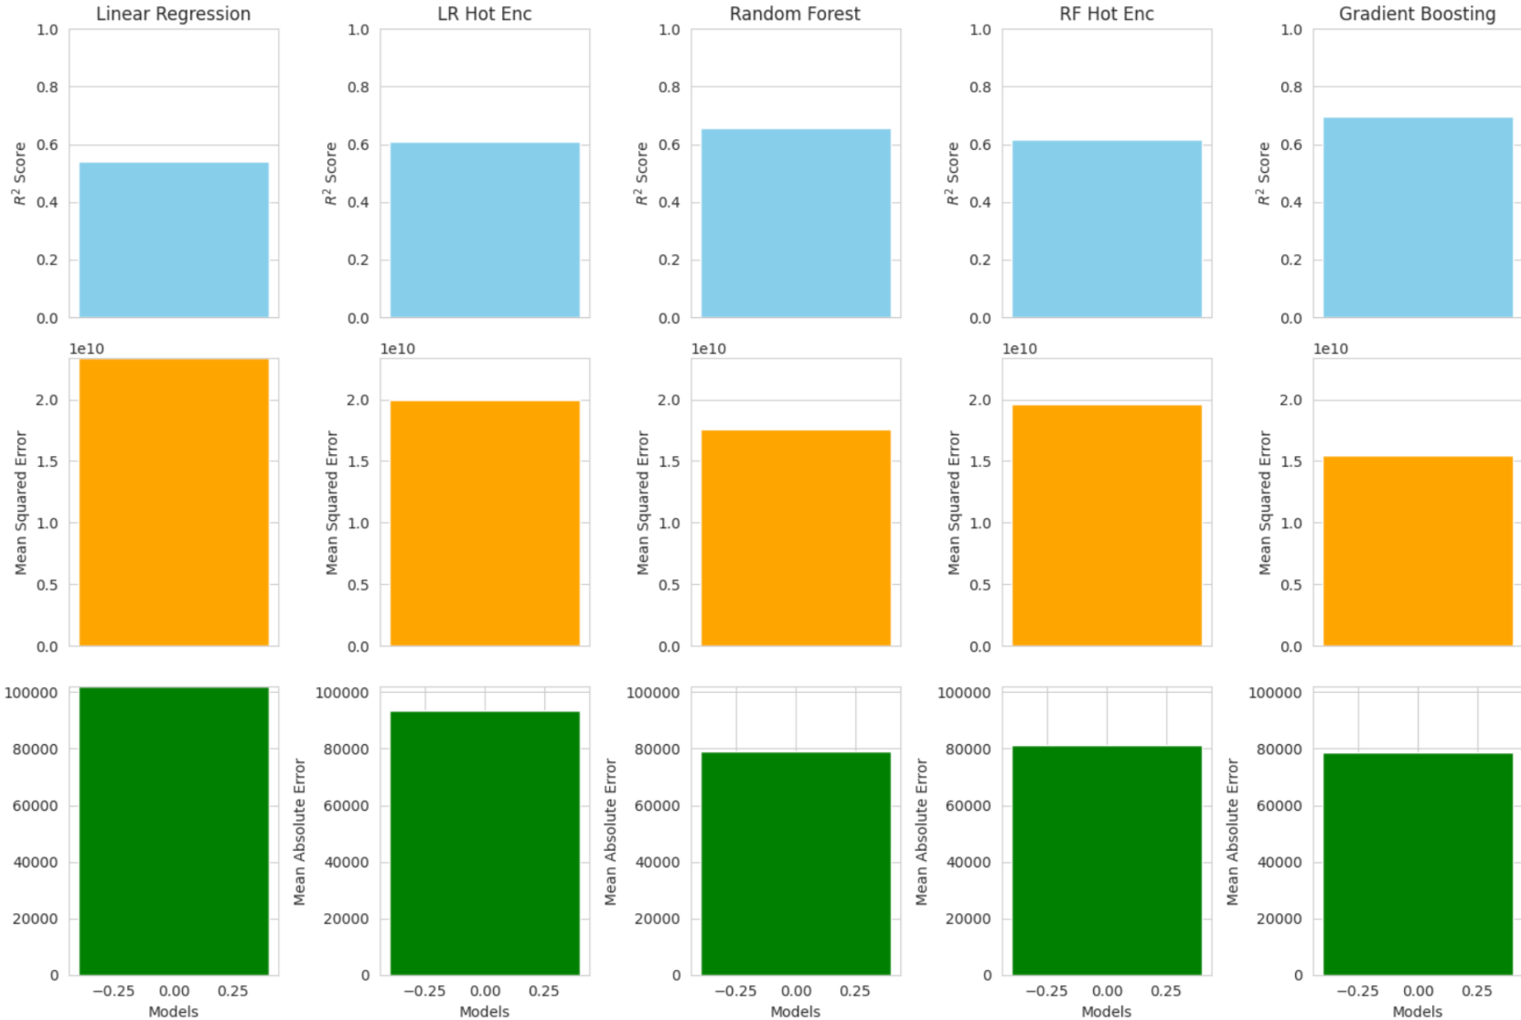
The Models: Kansas City, MO – 64128, 4 bed, 2000 sqft

Slide 23
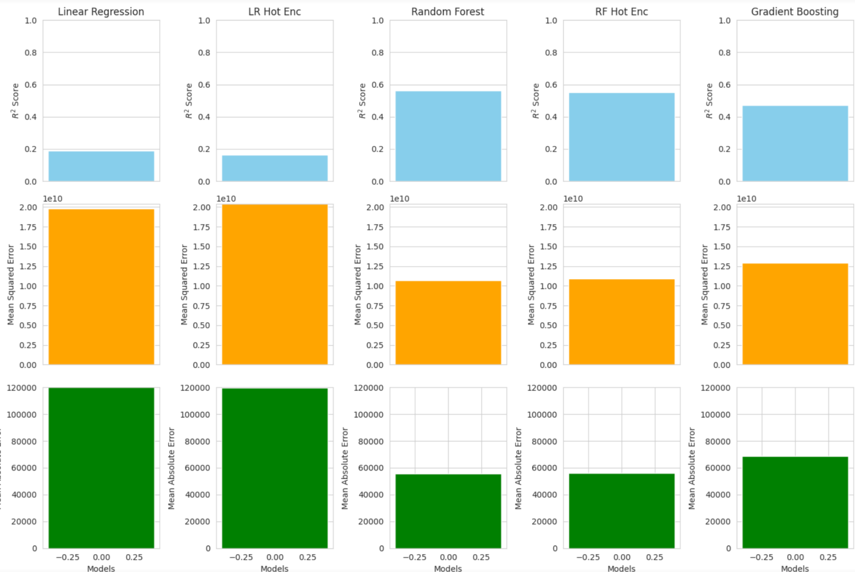
The Models: Kansas City, KS – 66102, 4 bed, 2000 sqft

Slide 24
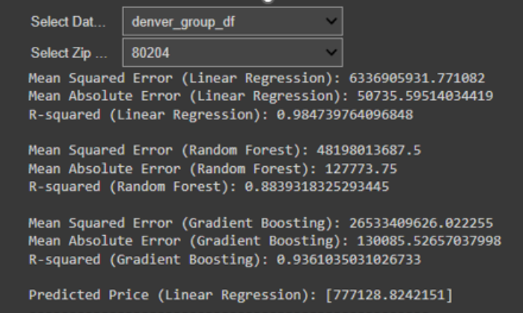
The Analysis: User Interaction!

Slide 25
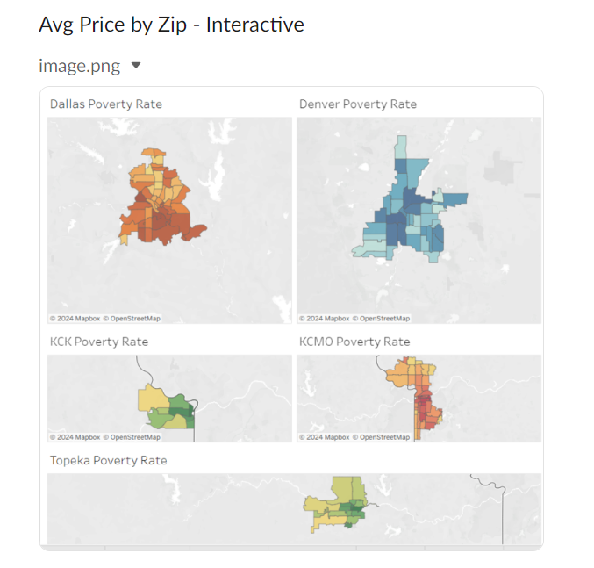
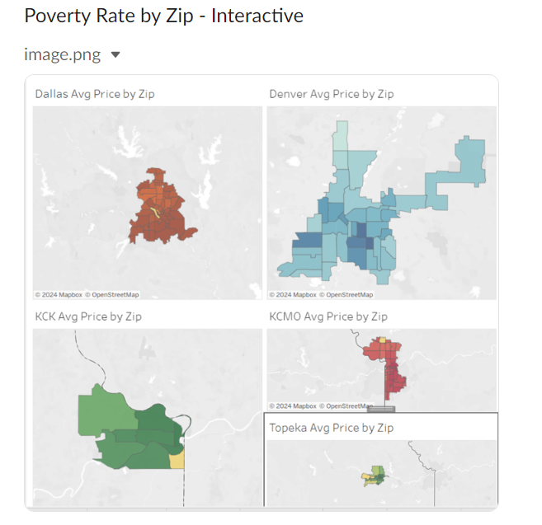
The Analysis:

Slide 26
Summary:
The better performing models tended to be random Forest and Gradient Boosting
The better technique for preprocessing is to add “One Hot Encoding” on the zip codes

Slide 27
Next Steps:
We limited the data to our particular needs to solve our problem.
Next time we think not to limit the data would give us a more dynamic model.
This would allow any zip, in any city, for any house size or bedroom quantity.
We searched for other data we thought might influence home prices, however the free data was hard to find. Examples:
Actual Addresses
Crime Rates
Market Supply and Demand
Possibly adding indexes such as consumer pricing

